Slide 1

Exploring Microservices in Existing Application Architectures
Dutch Oracle Architects Platform
Monday, 16th april 2018

Slide 2
Overview
Introduction
Survey Results
First Part – Pragmatic Microservices (inspired by QCon)
Dinner
Second Part - Pragmatic Microservices
In existing environments (with custom and standard applicatuions)
Cloud based
Data management
Workflow
Throughout:
discussion & brainstorm, questions & reactions
Drinks & jokes
Afterwards: socializing

Slide 3
Microservices – some promises & expectations …
Agility – Time to market, low cost & risk of change
Independent units – in development, deployment and ops
Less complexity, more appealing learning curve
Smaller units, easier to understand | fix | evolve, less risk
Higher availability
Even if some microservices are down, others can still (largely) function
Higher, Easier Scalability
Lower technical debt & quicker technical innovation

Slide 4

Soaring through the Clouds – The Sequel Cloud Native Microservices Architecture
EMEA PaaS Partner Forum
Budapest, March 2018

Slide 5
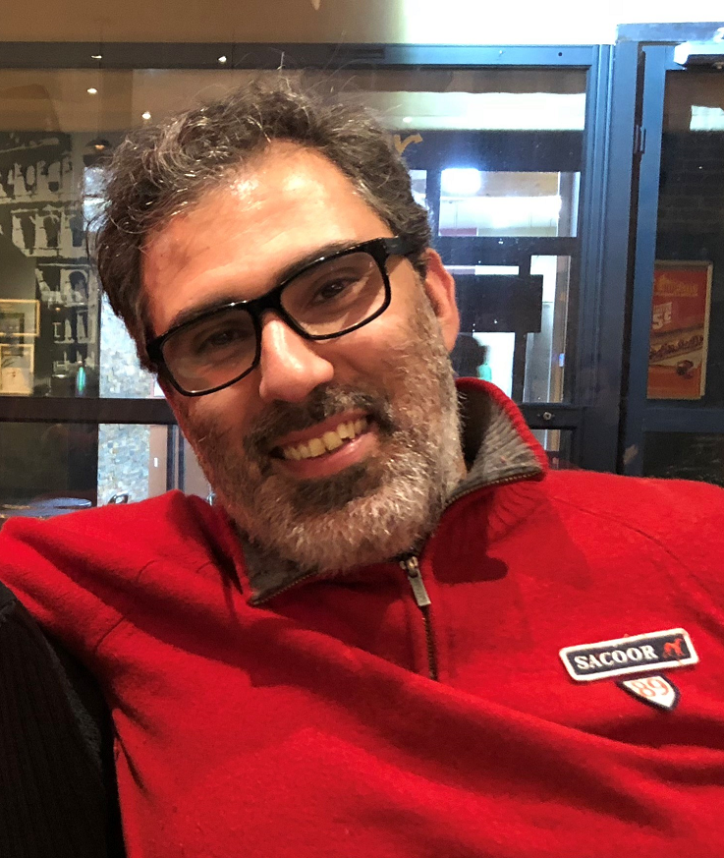
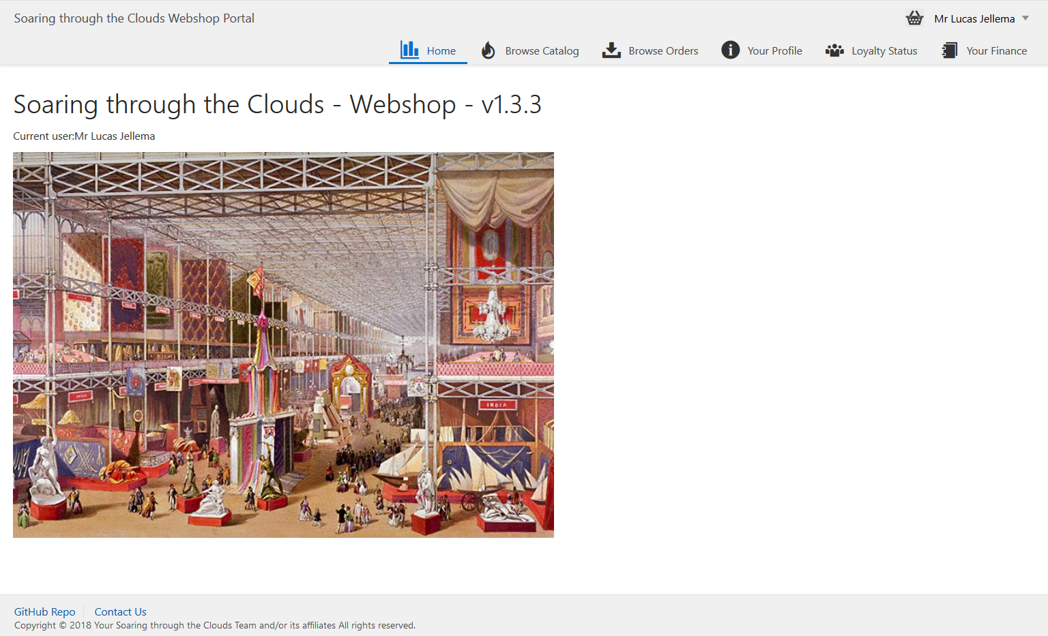
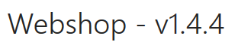
Meet Our Web Shop
Notes:
start with a demo of the Webshop - from customers signs and browses the products catalog to check out of the shopping basket, composing the order with delivery details and submitting the order; then checking the invoices and perhaps making the payment, reviewing the loyalty points and status and finally checking on the order progress (as the order gets picked, shipped and finally delivered).

Slide 6

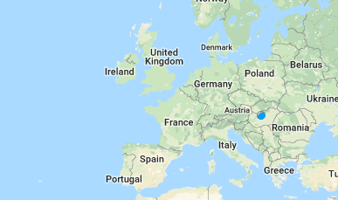


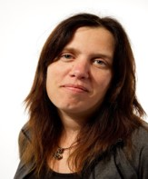
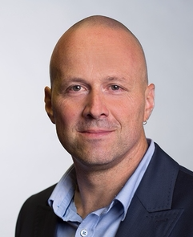
The Team

Slide 7
What’s the IT behind the Webshop?
Web Shop Portal
µ Customers
µ Orders
µ Products
µ Loyalty
µ Finance
µ Logistics
µ Customers
µ Orders
µ Products
µ Loyalty
µ Finance
Notes:
dazzle the audience with a quick dump of all technologies (and cloud services) used for putting the webshop together - for the UI, the API implementation, the datastores and the event bus.

Slide 8





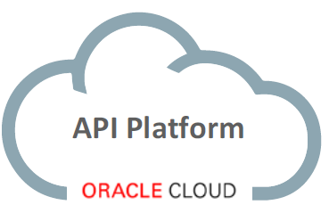
















API Portal
Web Shop Portal
µ Customers
µ Orders
µ Products
µ Loyalty
µ Finance
API Platform
Backoffice UI
λ
Event Schema Registry
Event Hub
Notes:
dazzle the audience with a quick dump of all technologies (and cloud services) used for putting the webshop together - for the UI, the API implementation, the datastores and the event bus.

Slide 9
Lessons Learned
An Architect has to be a Developer

Slide 10

Lessons Learned
An Architect has to be a Developer
Communication is essential – even if only about the touching points such as Events & APIs
Events are the backbone that allow decoupled interaction between independent microservices
EventHub CS (Apache Kafka) is the crucial backbone of our enterprise landscape
We need a more effective way to model choreographies. Who produces events, who consumes events, and chain of events. Both at design time and runtime
UI skillset is not same as backend service/API skills set. We can’t assume that everyone that’s a backend/API developer will want to learn UI skills.
Learning Kubernetes is absolutely required
Automating delivery of microservices is crucial
Fail fast, expect frequent failure of environments, introduce chaos deliberately (to learn how to deal with it)

Slide 11
Lessons Learned (page 2 / many)
Every “team” using their own implementation technologies and cloud environments works fine
Common event bus and monitoring infrastructure
Make sure all configuration settings (endpoints etc) and secrets are injected at deployment time and are NOT HARD CODED
To ensure scalability and quick redeploy and fail over, it is adamant that microservices are stateless
Data Bound(ed) Context makes Microservices independent
Every Microservice stores all data it requires – based on events
Git skills are essential!
For debugging and troubleshooting (across asynchronous interactions) we need good tooling to gain insight – design time and run time
Automated regression tests are extremely important
…

Slide 12
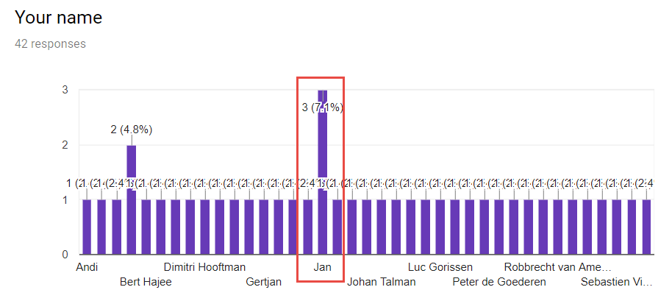
Survey under members of Oracle Architects Platform

Slide 13
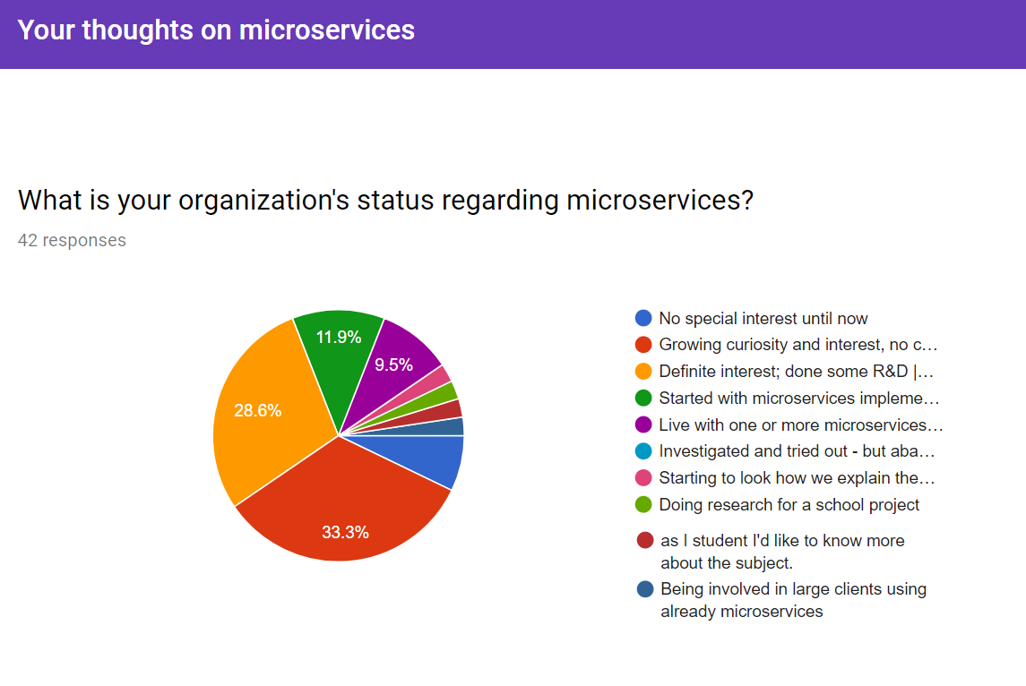
Notes:
https://docs.google.com/forms/d/1rhh_y83vxLllTLXlTDXYwbbYmaAapzsy3nqdrYLj_V4/edit#responses

Slide 14
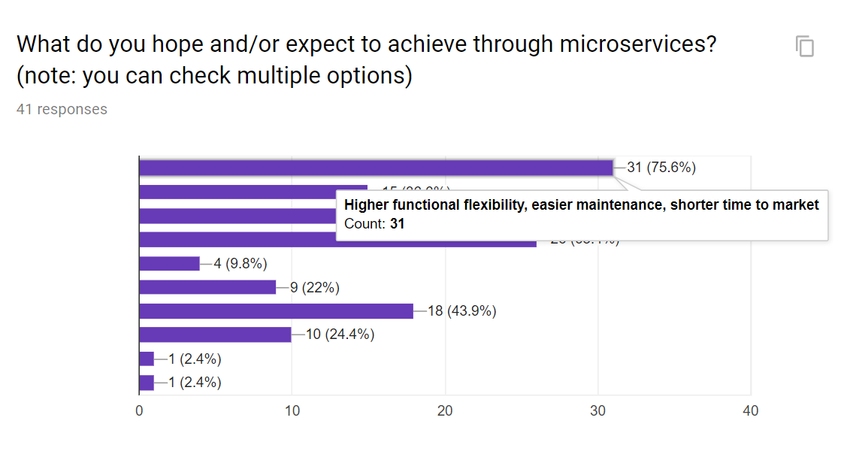
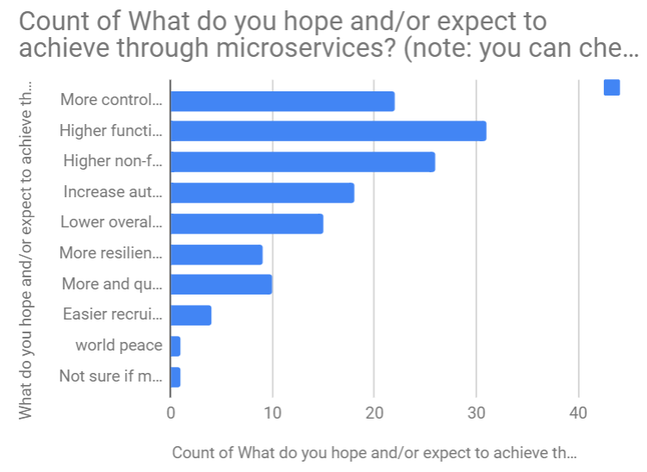
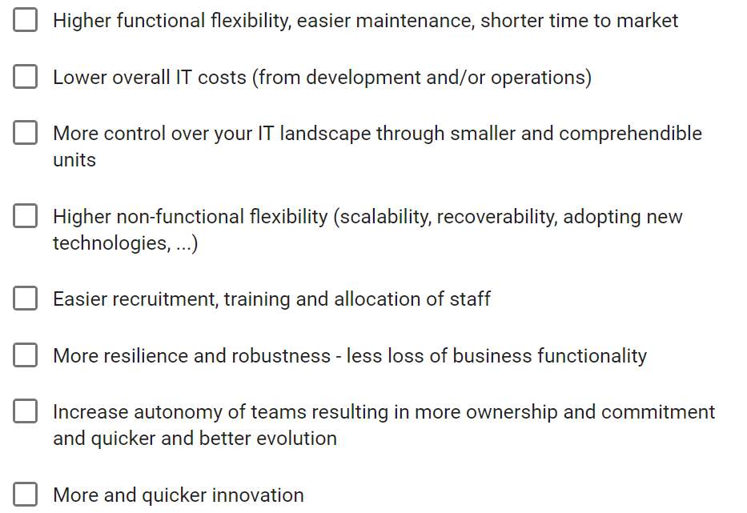

Slide 15
1
3
2
4

Slide 16
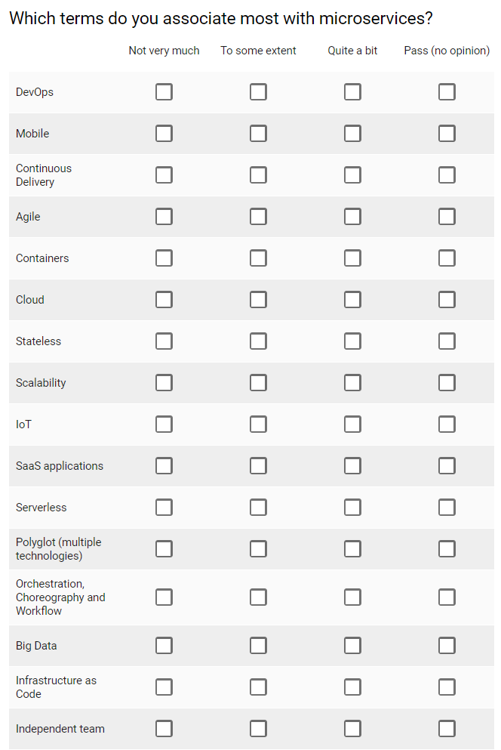

Slide 17
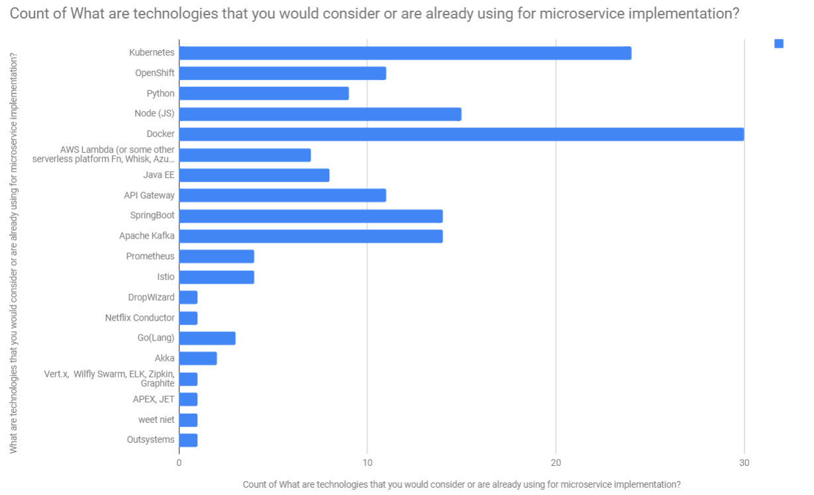
Technologies associated with Microservices

Slide 18
If you have already started doing microservices, what are the main challenges and potential pitfalls in your experience - regarding technology, process, organisation, culture?
Changing the way of working, responsibilities, processes
Mindshift to different architecture for architects, designers & developers (and others); scope of dockercontainers; microservice integration/orchestration datamanagement
The organization and administration around micro services. I am wondering how we will manage the whole thing. Will all departments be independent, go their own merry way and will we find out in “X” years’ time what the mess is we have landed ourselves into. Will be then still be in control?
1: Standardising what every MS needs to implement in our to be able to maintain control, overview. 2: Coding/Testing for failure, and monitoring/responding to failure.
Some of the challenges: thinking in microservices and technology

Slide 19
If you have already started doing microservices, what are the main challenges and potential pitfalls in your experience - regarding technology, process, organisation, culture?
Our challenge is to look for applications where microservices have added value, the drafting of a transition plan, how we integrate it with our existing environments and how we keep it manageable.
Granularity of services, functional or data APIs, IAM, technology driven
To get into an agreement on the "size of a microservice". In big projects I have ended up with a huge DevOps pipepeline to deploy excessive number of artifacts making the release and deployment process too slow.
technology, process, organisation, culture? Always lot of mission work to do to change a organisation.
Monitoring, debugging, consistent software quality
Currently working with Azure and we see it's still in development now. So functionality and possibilities are changing.
How to create the correct service boundaries (and size/complexity)

Slide 20
Which topics and themes would you like to see in our session on April 16th?
team roles in microservice development, testing. Managing cross-product projects
Microservice design and dealing with Master / Reference Data
central logging, authentication and authorisation, DTAP street
eventsourcing/CQRS! ; best practices/microservice patterns; praktijkverhalen
Ik ben nog zoekende hoe of wat met Micro services. Do’s & Dont’s, guidelines, ....
Your experiences with achieving a microservice-based architecture with cloud services as Google Cloud Platform or AWS.
Implementation of microservices, orchestration of microservices, microservices for start-up's
How to manage a landscape with microservices with multiple teams. What to use for storage. Cross-service references.
e.g. security and logging/monitoring
Good explanation of Microservices and how to place it within the current IT-landscape
Definition, principles, benefits

Slide 21
Which topics and themes would you like to see in our session on April 16th?
where has microservices added value, how to integrate with existing envirement and how to keep it manageable.
What can Microservices mean for our organization?
just interested in new technologies
Are microservices suitable for large data driven applications?
What about security, service discovery, health monitoring & performance, back pressure, failover ? Monitoring, eg traceability, throughput and latencies between applications and databases in a Microservices Architecture?
Service granularity , Microservice management.
Defenition of microservices, benefits, risks, architectures
Impact of microservices to our work of Solution Architect. What should we do differently? Where to focus on more than before? What is an architecture ready user story for a microservice? How to do the governance?
Best practices for designing and implementing, experience with Microservices in different enterprises.

Slide 22




Thank you!
Blog: technology.amis.nl
Email: lucas.jellema@amis.nl
: @lucasjellema
: lucas-jellema
: www.amis.nl, info@amis.nl

